Slide 1

Predicting Programming Languages from Stack Overflow Questions
Varun – 2K18CSUN04024
Sagar – 2K18CSUN04014
Shubham – 2K18CSUN04020

Slide 2

Motivation
With the ever-growing reserves of developers and researchers alike, computer programming has gained rapid traction in the recent years, as such it’s not startling for some of the blue-chips like Stack Overflow, hoarding a well-curated set of Questions and Answers on a wide range of topics in computer programming to advance in the recent years. Thus, it has become more important than ever to provide an alternative to the currently in place tagging system on these websites that relies entirely on its user to correctly input the tags of the programming language of the questions posted.
It is also not out of league to accidentally tag a question incorrectly, which may also prevent the user from getting correct answers. In such cases, moderators have to step in to close the thread or re-tag the question appropriately. So, we are trying to reduce the workload from the moderators or users and allowing our deep learning model to take their place.

Slide 3

Introduction
In our research, we propose a conventional yet effective deep learning model employing the concepts of Natural Language Processing with Gated Recurrent Neural Networks to predict the programming language of the question posted on Stack Overflow. Moreover, as evident[1] from various researches in the field of Natural Language Processing that since Gated Recurrent Unit Networks have fewer parameters due to the absence of output gate, they are more memory efficient than their Long Short Term Memory counterparts, and thus are well-suited for our prospect.
However, one must notice it is also worth trying a Deep Convolutional Neural Networks coupled with Word2Vec, that employs dynamic k-max pooling, where the filter can span across variable ranges while performing sentence modelling. However, since most of DCNN struggles to preserve the sequence order of the data[2], they are still very unlikely to outperform GRU or even LSTM.

Slide 4
Related Work
SOTagger – Towards Classifying Stack Overflow Posts through Contextual Tagging
A.S.M Venigalla, et al. in [3] proposed automated identification of questions of Stack Overflow using Latent Dirichlet Allocation in 6 categories. Using these categories, they have built some Machine Learning models, namely Linear SVC, Logisitic Regression, Multinomial Naïve Bayes and Random Forest Classifier, out of which Linear SVC provided the best accuracy of 78.5%.
Predicting Tags for Stack Overflow Posts
C. Stanley, et al. in [4] explored the Stack Overflow dataset and developed an ACT-R inspired Bayesian probabilistic model that can predict the hashtags used by the author of the post. The model is 65% accurate when tasked to predict one tag per post. It is achieved by choosing the tag that has the highest log odds of being correct, given the tag’s prior log odds of occurrence and adjusting for the log likelihood ratio of the words in the post being associated with the tag. The model is a successful case showing that ACT-R’s declarative memory retrieval equations are relevant.
Extracting Knowledge from Stack Overflow Posts
J.F Baquero et al. [5] proposed to build a classifier model that predicts languages using the content, such as text and snippets of source code, of a question. This method produces word embeddings in which each term of the question is represented in a vectorial space. After successfully conducting multiple experiments, the model showed the accuracy of 60.88% accuracy when using only textual information. However, the accuracy significantly decreases when used with code snipped, it resulted in an accuracy of 44.61%.

Slide 5

Dataset & Preprocessing
DATASET
For our research, we have used an open dataset, consisting of over 2 million posts from Stack Overflow. The dataset consists of ThreadID, UserID, Creation Date, Title, Body, Answer and Tag, etc.
DATA CLEANING & PREPROCESSING
We started with cleaning our dataset, which including dropping null rows as well as irrelevant features, like ThreadID, UserID, Creation Date and Answer. Once that was done, we proceeded with cleaning out HTML tags from the Title and Body. To minimize the computation power, we have selected top 10 most common languages for our research. Once cleaning and feature selection was completed, we proceeded with applying various preprocessing technique, commonly used in Natural Language Processing, such as Tokenization and Pad Sequencing.
Tokenization:- It is a process of splitting a string into a list of tokens. One can think of token as an individual word in a sentence. Following tokenization, we converted all the tokens into their respective sequence, meaning providing each unique token a unique integer for its identification.
Pad Sequencing:- Since each title and body contain different number of token, we are required to convert the token sequences of variable length into same length. Since, deep learning models work efficiently with data with consistent number of features. It also performs lemmatization on the words before converting them.
For our research, we decided to choose a maximum length of 20 sequences for titles and a maximum length of 600 sequences for body contents.

Slide 6
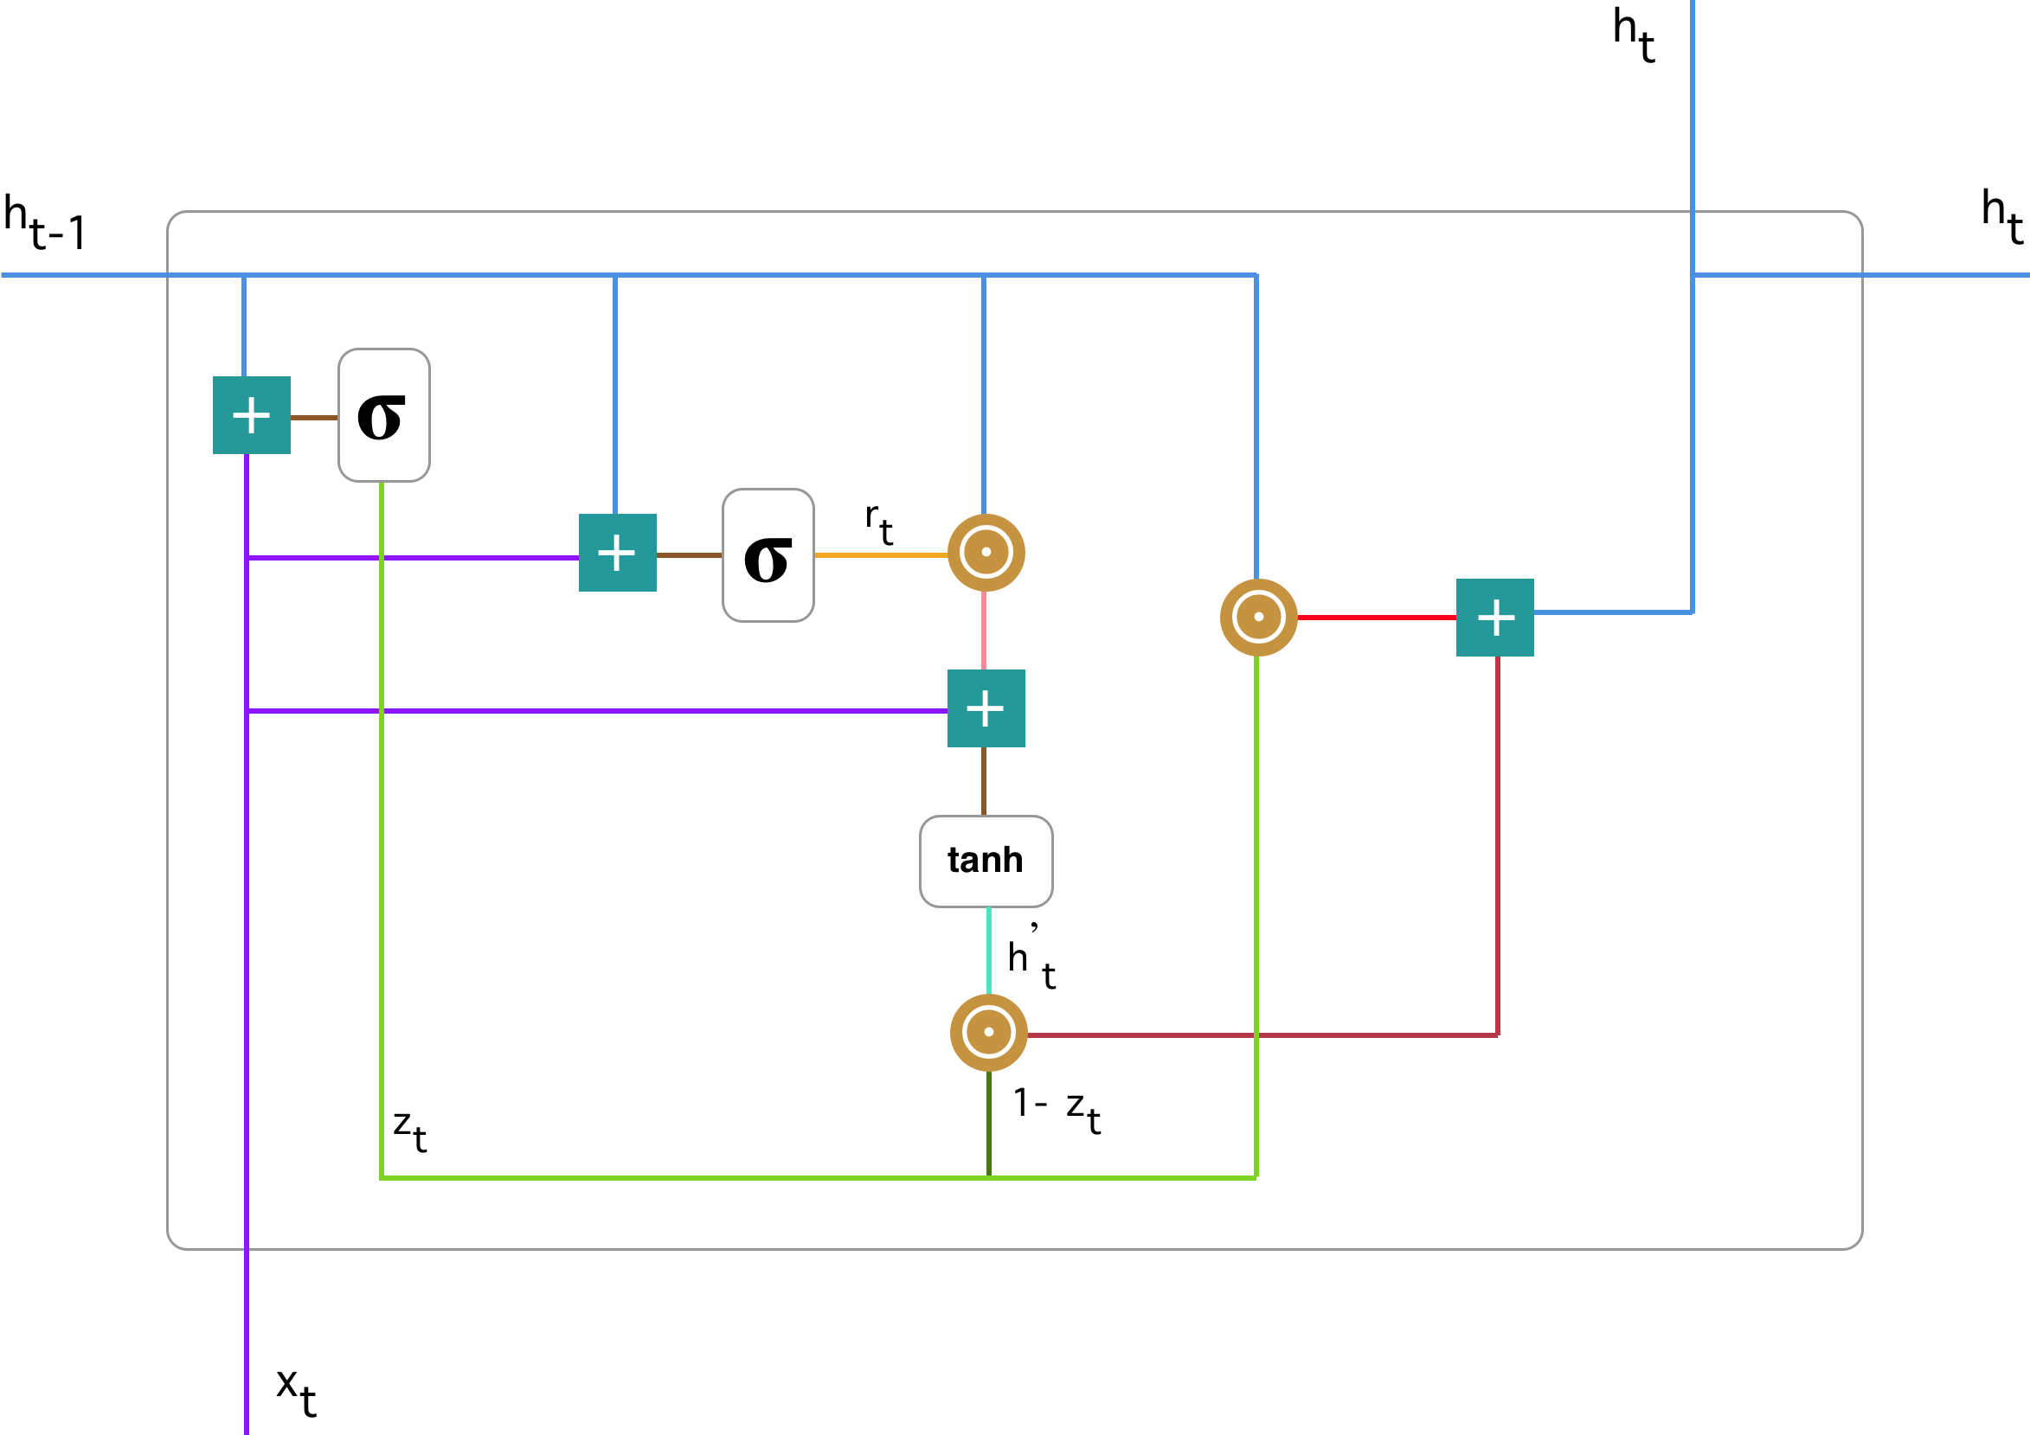
Gated Recurrent Unit (GRU) Networks
GRU Networks are improved version of standard Recurrent Neural Network. To solve the vanishing gradient problem of a standard RNN, GRU uses Update Gate and Reset Gate.
Basically, these are two vectors which decide what information should be passed to the output. The special thing about them is that they can be trained to keep information from long ago, without washing it through time or remove information which is irrelevant to the prediction.
Update Gate: We start with calculating the Update Gate for time step t. When the current input is plugged into the network unit, it is multiplied by its own weight. The same goes for the output for the previous t-1 unit. Both results are added together, and a sigmoid activation function is applied to squash the result between 0 and 1. The update gate helps the model to determine how much of the past information needs to be passed along to the future.
Reset Gate: Essentially, this gate is used from the model to decide how much of the past information to forget. As before, we plug in output from previous t-1 unit and current input, multiply them with their corresponding weights, sum the results and apply the sigmoid function.

Slide 7
Gated Recurrent Unit (GRU) Networks
Current Memory Content: We start with the reset gate. We will introduce a new memory content which will use the reset gate to store the relevant from the past. We multiple the current input with its weight, similarly with the output from the previous t-1 unit. Then we calculate element wise product between reset gate and product of last output with its weight. This will allow us to know which information will be removed from the previous time steps. Then, we sum all the values and apply tanh activation function.
Final Memory at Current Time Step: As the last step, the network needs to calculate current output which holds information for the current unit and passes it down to the network. In order to do that the update gate is needed. It determines what to collect from the current memory content and what from the previous steps.
This eliminates the vanishing gradient problem since the model is not washing out the new input every single time and keeps the relevant information and passes it down to the next time steps of the network which is why they can perform extremely well even in complex scenarios.

Slide 8
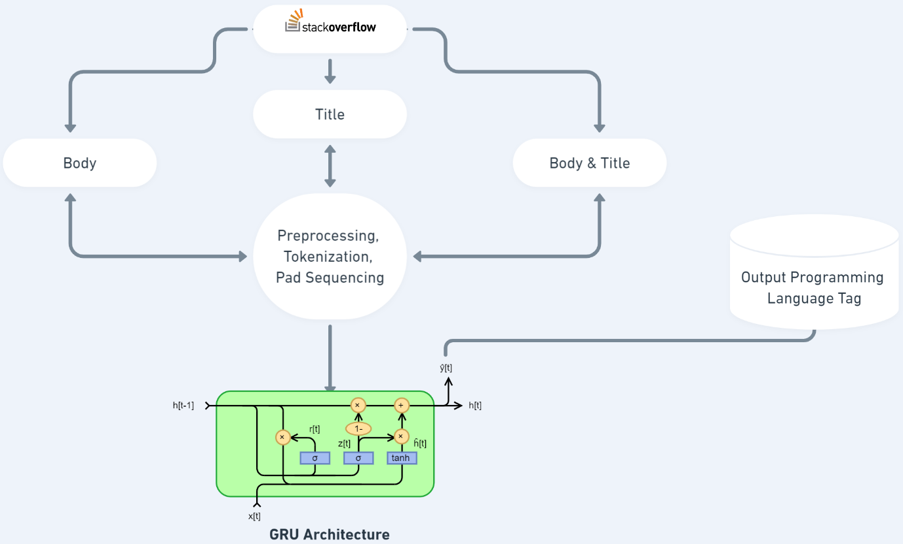
Data Flow

Slide 9


Performance Evaluation
We have employed K-Fold Validation to analyze the performance of our neural network; we divided our training data in 50 equal subsets, out of which 49 subsets are to train the model, while the remaining 1 subset is used to test the accuracy of the model.
We have employed conventional method of Accuracy (ACC) to evaluate the model. The accuracy of the model is calculated with the help of given formula.
Where TP (True Positive) and True Negative (True Negative) are the correctly predicted values, while FP (False Positive) and FN (False Negative) are incorrectly predicted values.

Slide 10

Experiments & Analysis
The experiments were carried out on both local and cloud-based virtual machines. The local experimental setup included the following specifications:-
Intel® Core™ i7-8700K Processor
Nvidia GeForce RTX 2080 Ti
32 GB DDR4 @ 3,000 MHz Memory Module
For cloud-based virtual machine, we opted to carry out our experiments on Microsoft Azure platform with Azure for Students subscriptions. We tried different GPU instance to find out which specification would require the least amount of time for training our model. The different GPU instances have been formulated below.
From the above table, we can conclude the Nvidia GeForce RTX 2080 Ti could perform efficiently on Title Only and Body Only, but fails to perform on Title + Body, which could be resolved by Nvidia Tesla K80.
GPU Instance | VRAM | Trained On | Time Taken
Nvidia GeForce RTX 2080 Ti | 11 GB | Title Only | 35 mins
Nvidia Tesla K80 | 24 GB | Title Only | 1 hr. & 30 mins
Nvidia GeForce RTX 2080 Ti | 11 GB | Body Only | 1 hr. & 25 mins
Nvidia Tesla K80 | 24 GB | Body Only | 3 hr. & 40 mins
Nvidia GeForce RTX 2080 Ti | 11 GB | Title + Body | Memory Overflow
Nvidia Tesla K80 | 24 GB | Title + Body | 5 hrs. & 10 mins

Slide 11

Results
After performing a series of experiments, we observed that our model produced a staggering accuracy of 97.38% when trained on Title + Body. We initialized the model to perform 5 iterations (epochs) for each experimental parameter as shown below:
From above table, we can conclude that the model works best when given both title and body of the question. Further, we have also compared our model with some of the other researchers who have performed similar researches as well. The comparison is shown below:
From above comparisons, we can observe that GRU works better than all the other models when it comes to predicting programming languages from Stack Overflow posts.
Trained On | Loss | Accuracy (%)
Title + Body | 0.2996 | 97.38
Body Only | 0.3437 | 84.17
Title Only | 0.6436 | 79.21
Model | Accuracy (%)
GRU | 97.38
XGBoost | 91.10
Linear SVC | 78.5
SVM | 60.88

Slide 12
Conclusion & Future Scope
This research deals with a seemingly trivial yet, significant problem revolving around predicting the programming language from posts on general programming website-cum-forum. One can easily conceptualize from the models proposed here that a Deep Learning model tend to work well with more data, Moreover, we can also state that it is plausible to predict the tags for programming languages employing multiple languages at the same time, for instance Cython.
Though predicting programming languages from the textual information has experienced its fair share of attention in the recent years, it still has tremendous possibilities yet to be explored as such, though the existing tools used in tagging the programming languages are somewhat intuitive but, they are often overly dependent on the users to either manually type the tags associated with the code or tag the associated language with the code. However, the recent advances in Natural Language Processing to produce valuable insights from the text-based data have made it more than obvious that unsupervised machine learning techniques can be used to produce more astute and reliable results.
For our future prospects, we would like to extend our model to generalize on broader areas not only specific to Stack Overflow, like code posted on competitive programming websites, programming blog post, official libraries documentation, bug repositories, etc. Moreover, we would also like to capture the sentiments of the responses on the post to filter extremely arrogant or vile comments that can hurt the self-esteem of the user who posted the question.

Slide 13
References
Dey, R. and Salem, F. M., “Gate-Variants of Gated Recurrent Unit (GRU) Neural Networks”, arXiv preprint arXiv (2017).
S Bai, JZ Kolter, V Koltun, "An empirical evaluation of generic convolutional and recurrent networks for sequence modeling", arXiv preprint arXiv:1803.01271, 2018
Akhila Sri Manasa Venigalla, Chaitanya S. Lakkundi, Sridhar Chimalakonda, "SOTagger - Towards Classifying Stack Overflow Posts through Contextual Tagging", 2019
Stanley, Clayton. “Predicting Tags for StackOverflow Posts.” (2013).
Juan F. Baquero, Jorge Camargo, Felipe Restrepo-Calle, Jairo Aponte, "Predicting the Programming Language: Extracting Knowledge from Stack Overflow Posts", 2017
https://www.kaggle.com/stackoverflow/stacksample

